Slide 1



Spectroscopic Analysis of Quantum Spin Liquids and Nanophotonic Cavities
Terry Phang
Mentor: Dr. Benjamin Lawrie
Materials Science and Technology Division
Notes:
Hi, my name is Terry Phang and I am a SULI intern in Dr. Ben Lawrie’s group. This semester, I’m working on computational techniques to perform analysis on multidimensional and hyperspectral quantum materials datasets.

Slide 2

https://commons.wikimedia.org/wiki/Category:Images
Notes:
Quantum materials exhibit unique electronic, magnetic, and optical properties, and have powerful applications in energy production, information science, and computing. However, dealing with the large amounts of experimental data we retrieve from them is not trivial. Today, I’ll talk about how I’m developing code to study two types of materials: Quantum Spin Liquids and nanophotonic cavities.

Slide 3
A
B
Liquids
Notes:
Let’s dive right in by talking about something you’re all familiar with: liquids. In a liquid, you can know the arrangement of atoms in region A, but that doesn’t mean you know the same about another region like region B. This is why liquids lack long range order.

Slide 4

Quantum Spin Liquids
?
<14 K
?
Notes:
Similarly, a Quantum Spin Liquid is a material that lacks long-range order in the orientation of its spins, even at low temperatures. Furthermore, it exhibits unique characteristics like long-range entanglement and fractionalized spin excitations due to the frustration of its magnetic moments.

Slide 5
RuCl₃ Honeycomb Lattice
Notes:
There are many promising candidates for Quantum Spin Liquids. Our group is studying Ruthenium Trichloride, because the theoretical model called the Kitaev model has predicted that its honeycomb lattice structure may harbor a QSL.

Slide 6
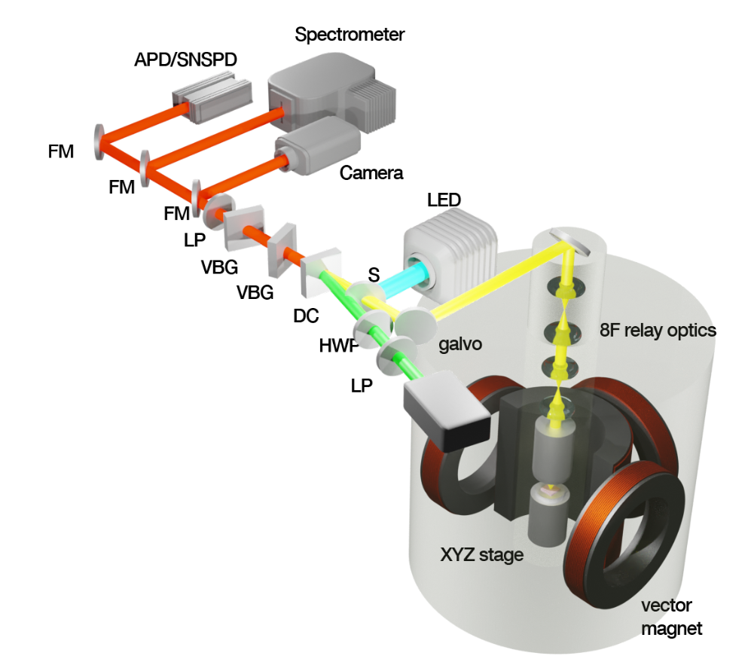
Notes:
To collect data, our group employed Raman Spectroscopy using the schematic shown on the slide. Raman Spectroscopy is particularly useful because it can also probe coupling to magnon and spinon states. These states can be used as identifying features of QSL’s.

Slide 7

Notes:
The Raman spectroscopy produces multidimensional datasets resolved by wavenumber, polarization, magnetic field, and temperature. In my research, I am writing code to analyze the trends in these datasets across these degrees of freedom.

Slide 8
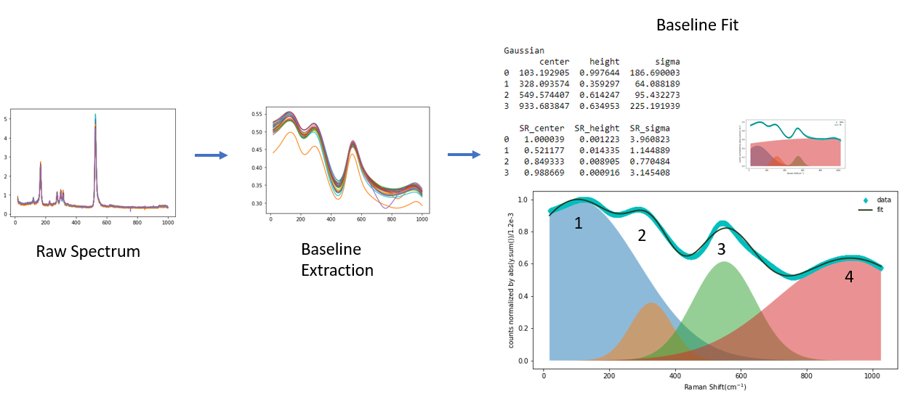
Notes:
The spectrum of our Raman data consists of two parts: the baseline and the peaks. The baseline may contain information about magnetic excitations of the RuCl3. To investigate this possibility, I separated the baseline and performed frequentist fitting with several different functions to observe trends.

Slide 9
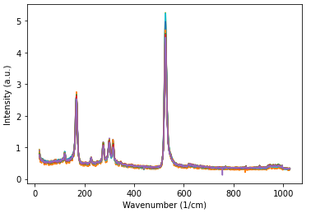
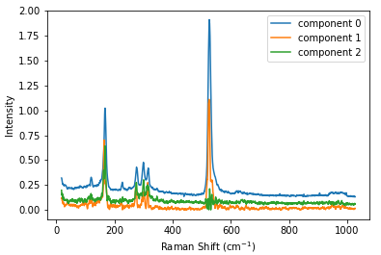
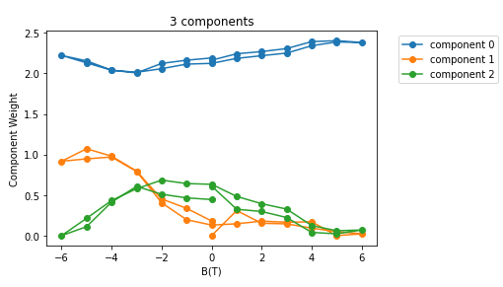


$$≈$$
$$⋅$$
Original Data
Components
Weights
Notes:
Another method I’ve applied to deal with these large datasets is to break it down into its constituent components through a process called nonnegative matrix factorization, or NMF. NMF also quantifies how much a given component contributes to the overall spectrum.

Slide 10

NMF
4?
2?
1?
5000?
3?
Notes:
However, one common challenge in NMF is that you must know the optimal number of components you want to break your data into beforehand. There is not a strong consensus on how to determine the right number, so I am exploring possibilities by cross validation with other methods.

Slide 11
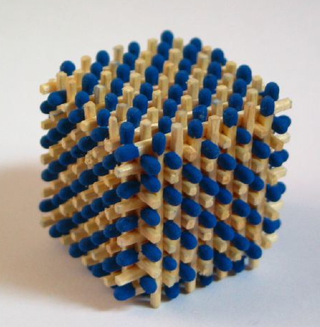
Notes:
Similar computational analyses can also be applied to study other quantum materials, such as nanophotonic cavities. A nanophotonic cavity is a nanoscale structure that exhibits strong light-matter interactions and interesting optical behaviors depending on its morphology.

Slide 12
electrons
photons
Silver Nanocube
Gold Thin Film
Notes:
The nanophotonic cavity I am working on is a silver nanocube on a gold thin film. The emission of light from this cavity was measured in response to excitation by incident electrons. This process is called cathodoluminescence, or CL microscopy.

Slide 13
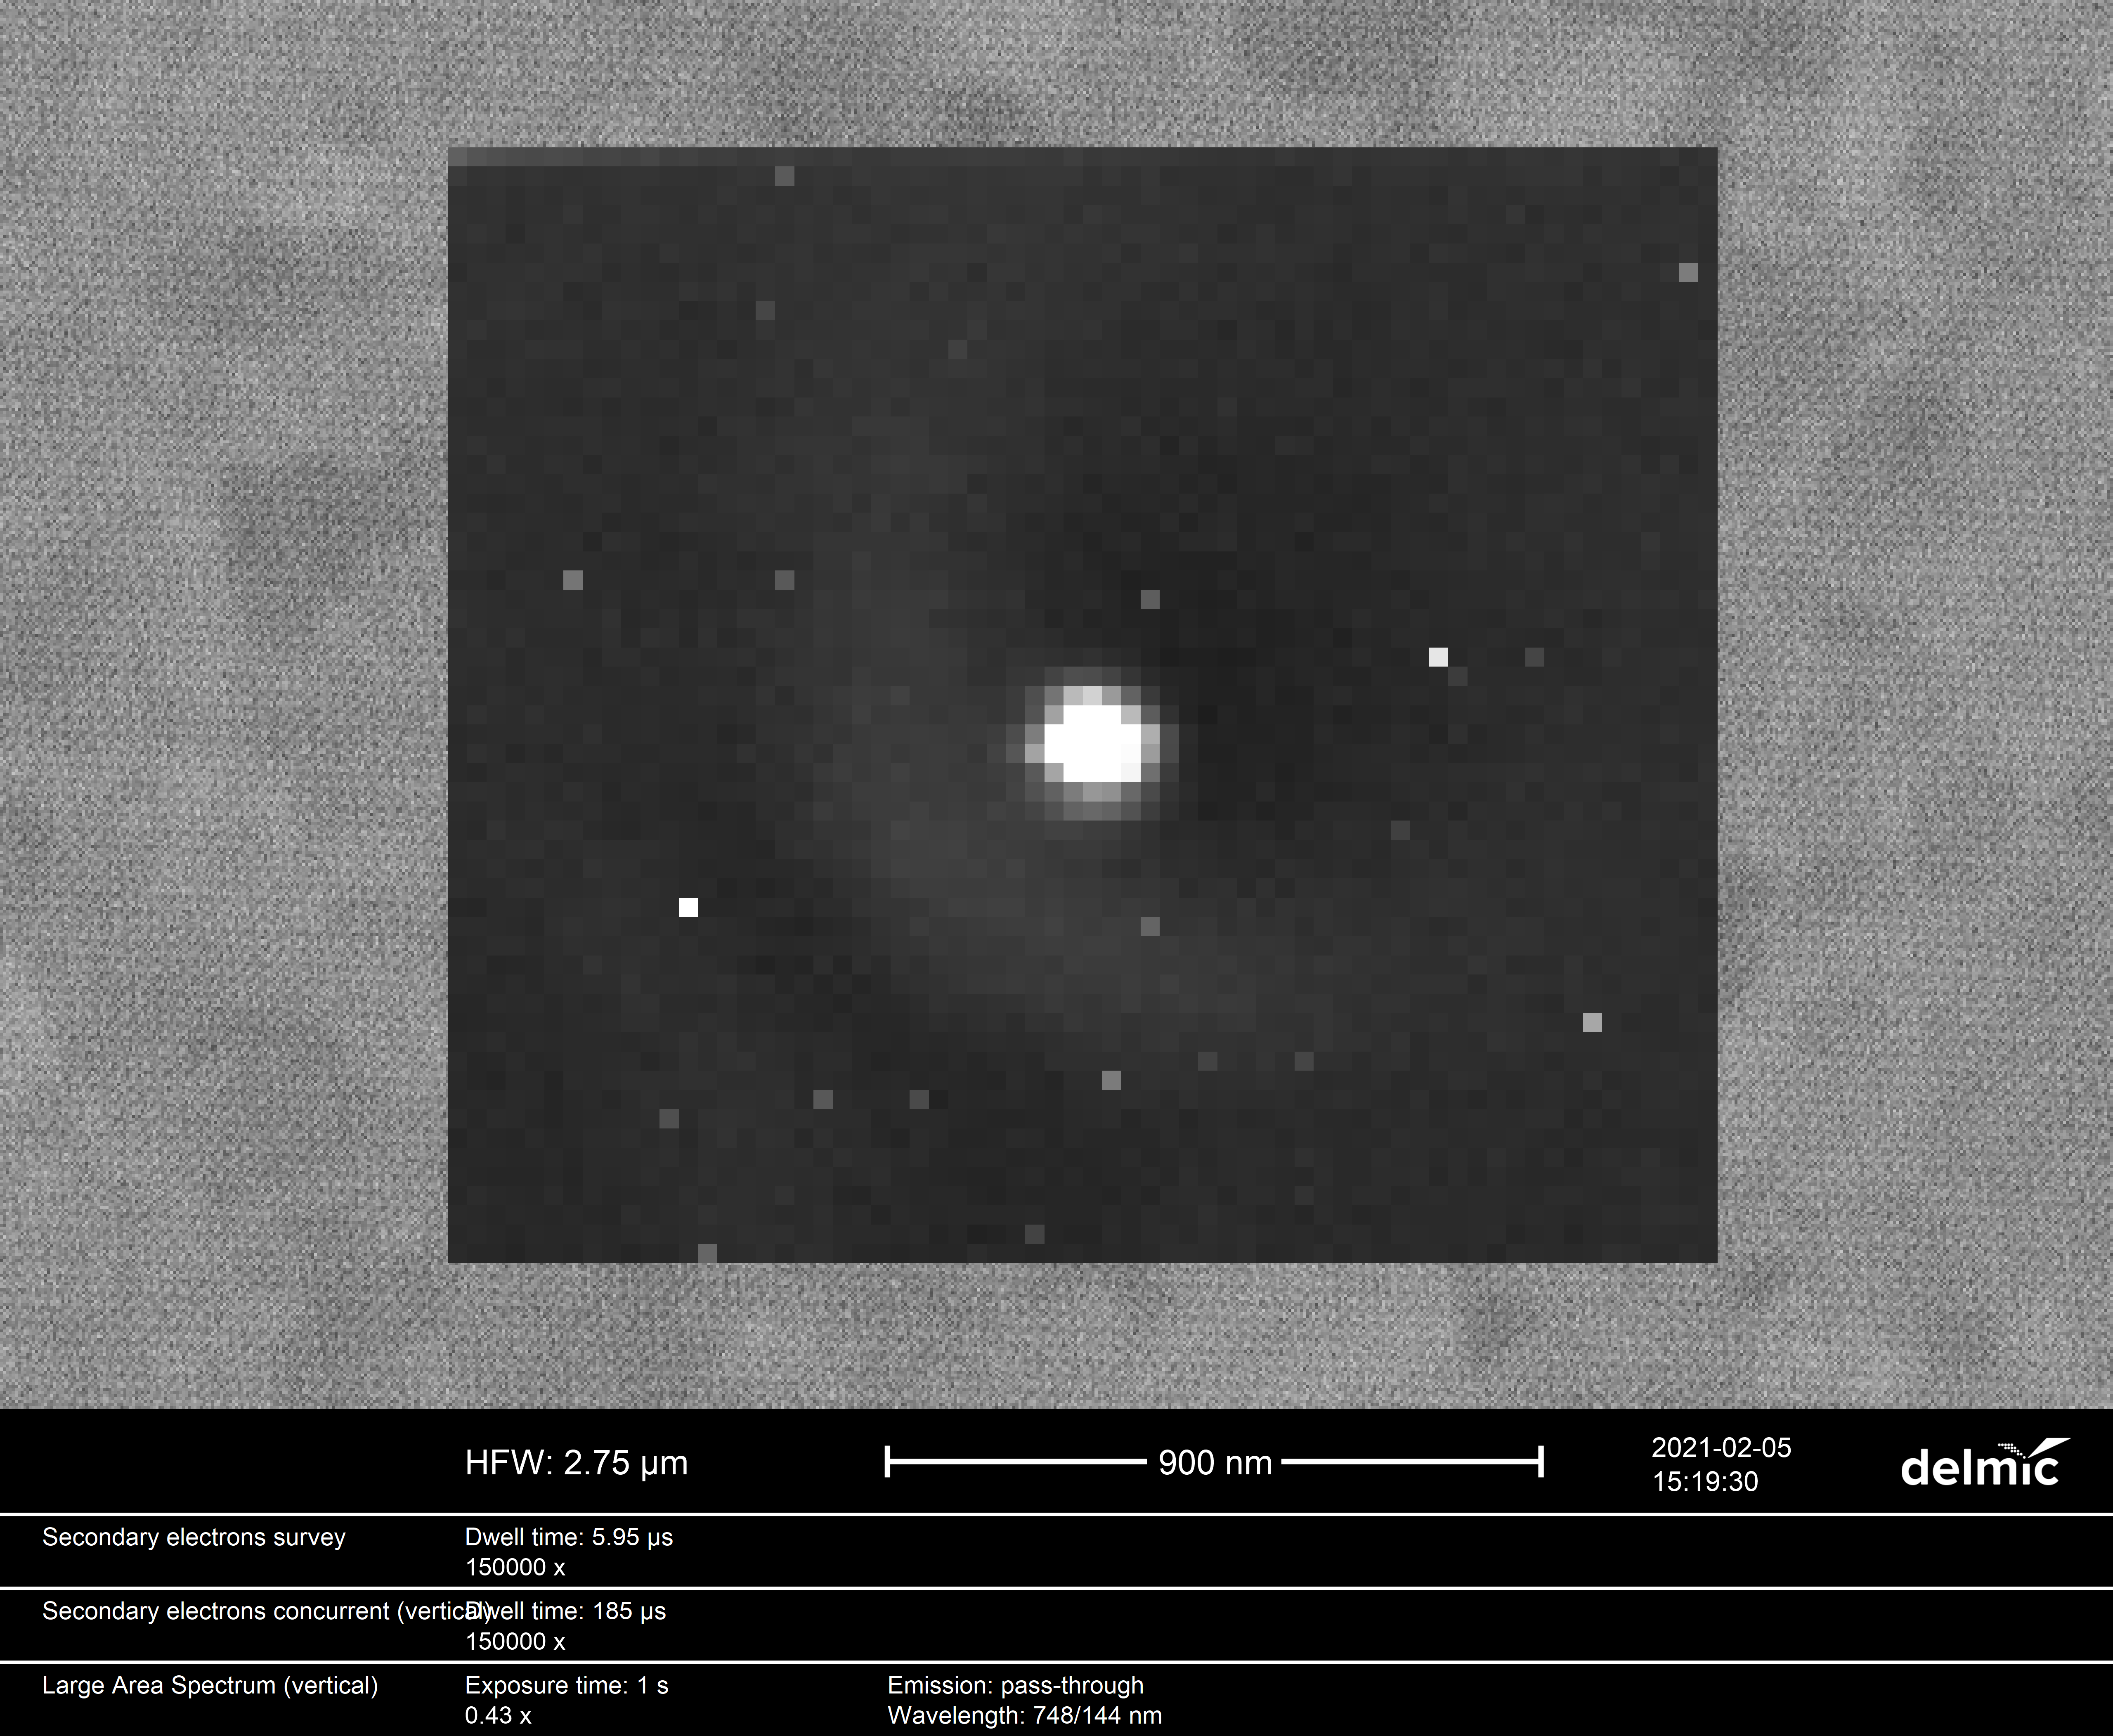
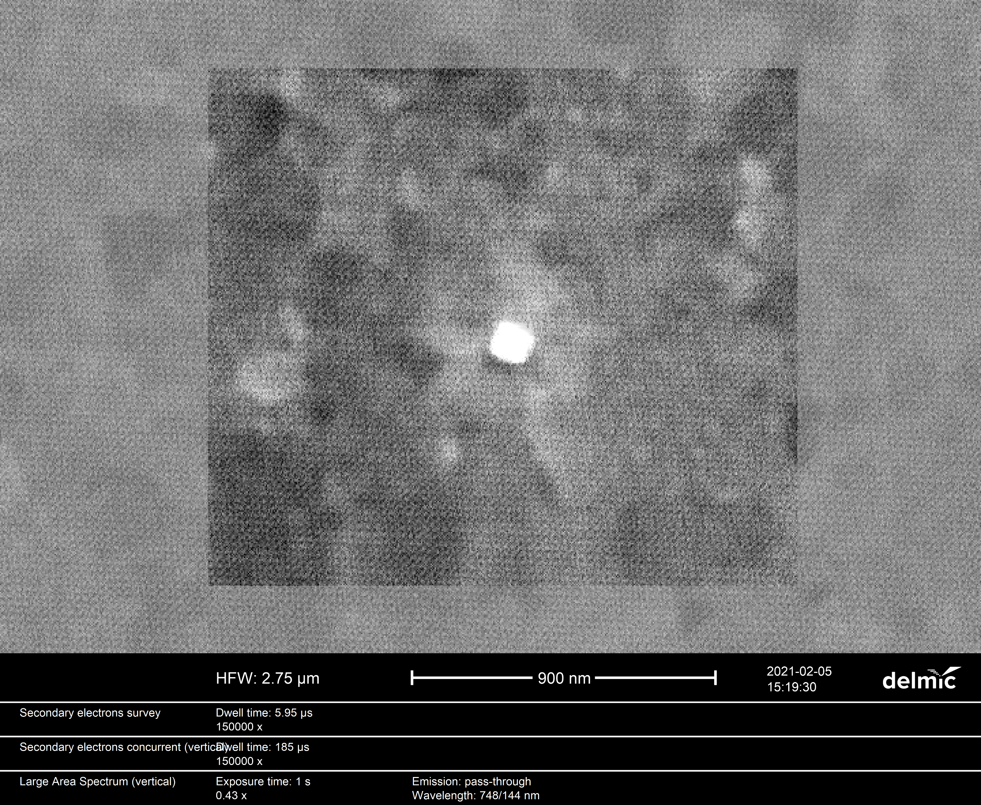
Cathodoluminescence
Scanning Electron Microscopy
Notes:
From CL microscopy, we get two datasets: one scanning electron microscopy dataset from an initial scan, and one spatially resolved cathodoluminescence dataset. The CL microscopy dataset reveals some interesting physics.

Slide 14
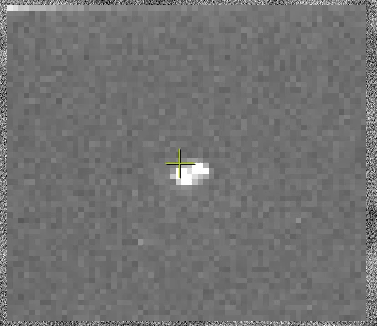
Notes:
For instance, notice the wavelike interference pattern that ripples outward from the nanocube. This is the result of constructive interference from between a surface plasmon polariton with the transition radiation. However, this interference is asymmetric, and the origin of this asymmetry is unclear.

Slide 15
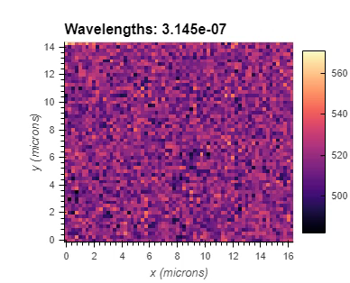
Notes:
The first order of business in analyzing this interference pattern is to produce software-like functionality in Python for convenient viewing. We want to investigate this phenomenon and how it depends on variables like position, wavelength, and polarization.

Slide 16
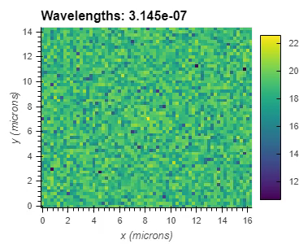
Notes:
To understand the origin of the asymmetric interference pattern, it might help to view the data in a different perspective. Here, the data has been transformed through a process called a fast fourier transform, or FTT, so that they are represented by their frequencies, revealing some clearer patterns.

Slide 17
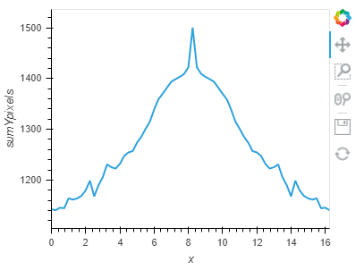
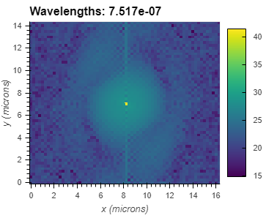
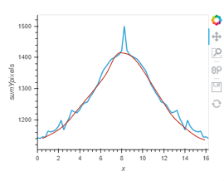
Slice
Data
Fit
Notes:
Going forward, it will be useful to slice the FTT and apply some of the fitting methods we saw in the Quantum Spin Liquid datasets. These will give us parameters we can plot as a function of other variables like wavelength and polarization.

Slide 18
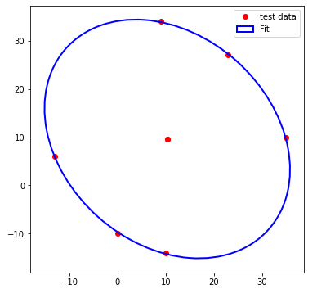
Slice
Data
Polar fits
Notes:
Due to the shape of the interference patterns, fitting data with circles or ellipses might also be useful for observing trends. Extracting the long and short axes of these ellipses can tell us something about how the interference patterns vary with wavelength.

Slide 19

https://www.flickr.com/creativecommons/
Notes:
Ultimately, one goal of my research is to contribute to a Python framework that can be applied for broader analyses of spectroscopic and microscopic datasets. This will lead to a more efficient analysis for a better fundamental understanding of quantum materials.

Slide 20


This work was supported in part by the U.S. Department of Energy, Office of Science, Office of Workforce Development for Teachers and Scientists (WDTS) under the Science Undergraduate Laboratory Internships Program (SULI) program at Oak Ridge National Laboratory, administered by the Oak Ridge Institute for Science and Education.
I would also like to thank my mentor Dr. Ben Lawrie as well as Postdoctoral Researchers Yun-Yi Pai and Vasudevan Iyer for their guidance on this project
Finally, thanks to fellow SULI intern Brian Lerner for his insights with Python and for working with me collaboratively.
Notes:
Thank you for listening to my presentation today! I would like to thank my mentor Dr. Ben Lawrie and his postdoctoral students Pai and Vasu for their guidance and for providing me with data, as well as fellow SULI intern Brian Lerner for sharing his experience with Python and working with me collaboratively.

